Slide 1
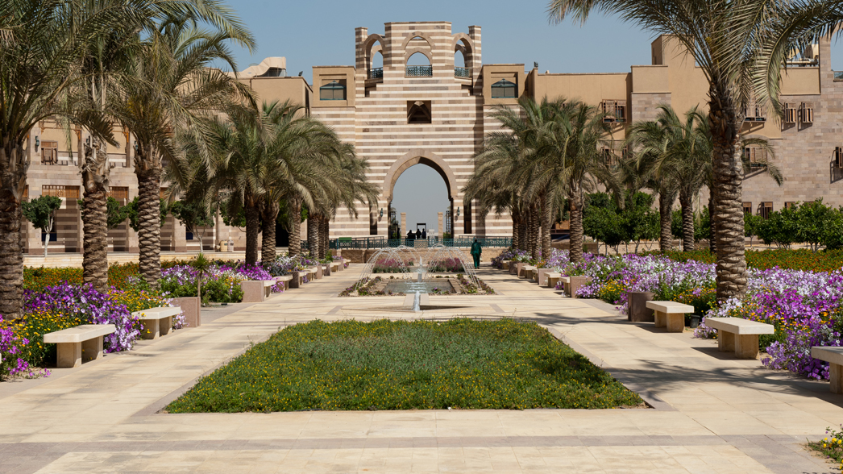
Methods and Tools Used in Global Cooling Watch and Global Cooling Pledge Progress Report
Omar Abdelaziz, Ph.D.
The American University in Cairo
Notes:
Exploring global responses to climate change challenges

Slide 2
Agenda for Global Cooling Initiatives
Methods for Monitoring Cooling-Related Goals
Tools Used in Global Cooling Watch
Tools Used in Global Cooling Pledge Progress Report
Consistency in Tracking and Its Importance
Notes:
In this presentation, we will cover an overview of global cooling initiatives, methods for monitoring cooling-related goals, the tools used in Global Cooling Watch, and the progress report for the Global Cooling Pledge. We will also highlight the importance of consistency in tracking and monitoring these initiatives.

Slide 3
Data Collection Techniques
Quantitative Approaches
Quantitative data collection techniques include methods such as surveys, questionnaires, and industry reports focusing on numeric values.
Qualitative Approaches
Evaluation of policy tools and developing estimates of how countries are advancing their sustainable cooling agenda.
Combining Techniques
Effective data collection often involves combining both quantitative and qualitative techniques for comprehensive insights.
Notes:
Data collection techniques involve both quantitative and qualitative approaches. Surveys, sensor data, and field studies are commonly used to gather information on cooling practices and energy use.

Slide 4
Tools Used in Global Cooling Watch
Notes:
A variety of tools are utilized in Global Cooling Watch to enhance monitoring and reporting. These tools facilitate data collection, analysis, and visualization, enabling stakeholders to make informed decisions.

Slide 5
Filling a Questionnaire through Desk Research
Questionnaire design
The questionnaire needs to capture all the required aspects of the cooling policy landscape in different countries
Implementation through desk research
Researchers worked on filling the questionnaire through desk research based on published policies and information
Validation
An effort was made for validating the results with the focal point – not 100% successful
Caveat
Not all researchers/policy makers understood the questions for their face value – this resulted in challenges with interpretation
Notes:
Remote sensing technologies play a crucial role in monitoring environmental conditions. Satellite imagery and aerial surveys are used to gather data on temperature changes and land use patterns.

Slide 6
Data Management and Visualization Software
Effective Data Analysis
Data management software enables efficient data analysis, helping organizations make informed decisions based on accurate information.
Visualization of Trends
Visualization tools help stakeholders identify trends and patterns, providing insights into the effectiveness of cooling initiatives.
Stakeholder Engagement
Effective data presentation enhances stakeholder engagement by making complex data understandable and actionable.
Notes:
Utilizing data management and visualization software is essential for analyzing and presenting data effectively. This software helps stakeholders visualize trends and outcomes related to cooling initiatives.

Slide 7
Global Cooling Pledge Progress Report
Notes:
The Global Cooling Pledge Progress Report provides a comprehensive overview of advancements made towards cooling goals. It includes key performance indicators and updates to ensure transparency.

Slide 8
Filling a Questionnaire through Communications with the Focal Point
Questionnaire design
The questionnaire design was improved based on lessons learned from Global cooling watch exercise
Communication with GCP
To ensure accuracy and timely response, questionnaires were pre-populated using the Global Watch Report data, and updated and filled through communications with the GCP focal point
Challenge
Slow response from GCP signatories, resistance due to the length of the questionnaire and the level of details
Notes:
Remote sensing technologies play a crucial role in monitoring environmental conditions. Satellite imagery and aerial surveys are used to gather data on temperature changes and land use patterns.

Slide 9
Consistency in Tracking and Its Importance
Importance of Data Accuracy
Data accuracy is critical for effective decision-making processes across various sectors and industries.
Validation Processes
Implementing rigorous validation processes ensures the data collected is reliable and trustworthy.
Standard Methodologies
Using standard methodologies aids in maintaining the integrity of data and improving data quality.
The Global Cooling Watch (GCW) is updated on biennial basis – important to ensure that reporting is consistent
The GCP has 16 commitments, tracking its progress requires
Rigorous framework
Data transparency
The GCP modeling is a subset of GCW modeling – need consistency between GCP and GCW

