Slide 1
Unpacking the Global Cooling Watch: Evolving Data & Trends
Presentation to
Future of Cooling Webinar
March 2025
by Ray Gluckman

Slide 2
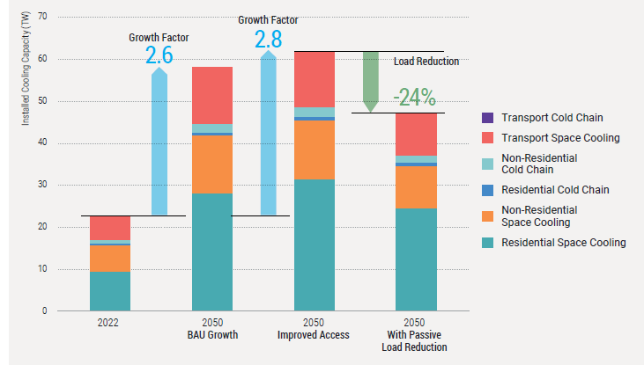
Cooling Equipment Stock Growth

Slide 3
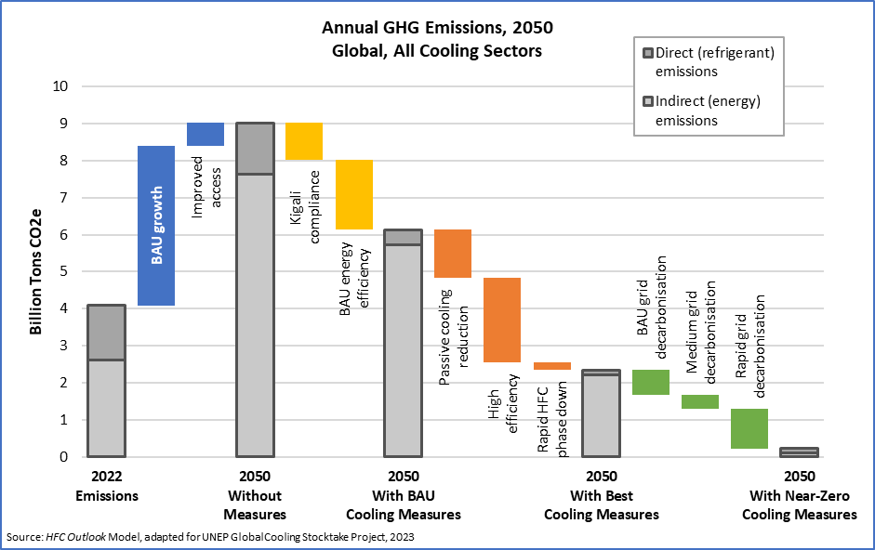
Global GHG Emission Reduction Potential for RACHP
Growth to 2050
BAU Cooling Measures
9.0
Best Cooling Measures
4.1 billion tons CO2e in 2022
6.1
Grid decarbonisation
Near-zero GHG emissions possible in 2050
36%
2.3
64%
0.2

