Slide 1
Notes:
Thanks for having me.
Our report was launched last year at the New York City Climate Week – you can find it online.
We have been also been doing a few sector specific deep dives as part of these cool talks – for example, be on the look out for a webinar on March 20 on space cooling.

Slide 2





Private Finance is Essential for the Transition to Sustainable Cooling, but Finance is Not Enough
Finance
(private and public)
Sustainable cooling across developing economies
1
The adequate supply of finance is essential
2
Policies and Regulation
Electricity access
Supply
chains
There are other factors required to support this transition
3
Non-financial factors have significant influence on the availability of financing and the capacity to mobilize private financing.
Notes:
One of the main messages of the report is that private finance is essential for the cooling transition – but finance is not enough.
Cooling cuts across many sectors. This requires the right enabling environment for action.
National cooling plans and other public policy instruments are an important step to coordinate between different agencies and to also coordinate with and get buy-in from the private sector.
Other drivers like local electricity access and supply chains maturity will also influence the availability of financing. There are also issues like verification of performance and reliability and insurance coverage.
For all these reasons, we treat cooling as an ecosystem where action across multiple levers of supply and demand is needed at the same time.

Slide 3
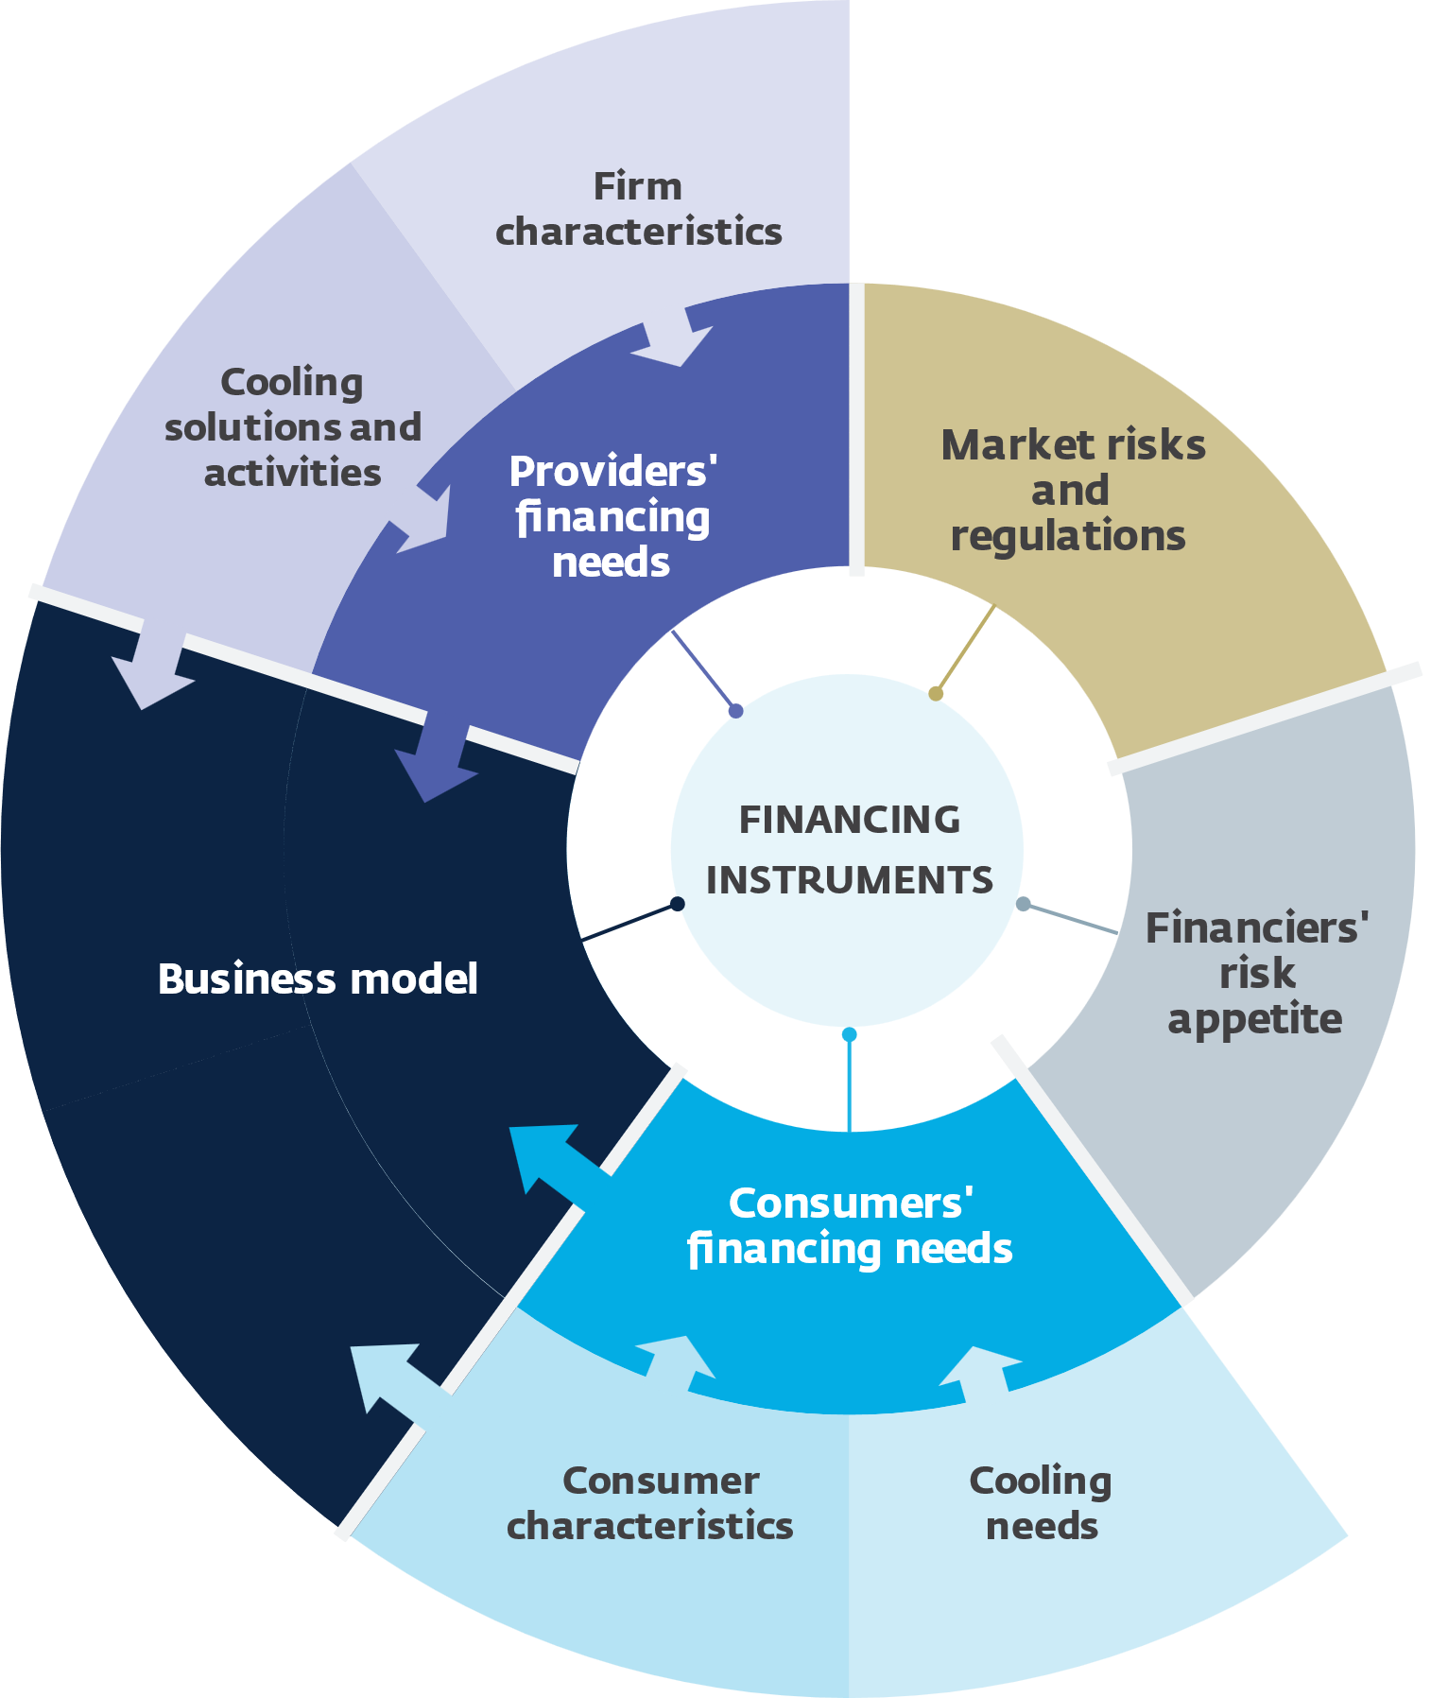
When it comes to Financing Sustainable Cooling: No Size Fits All!
The design of business models and financing instruments must consider:
4
Business model Examples:
Direct purchase
Asset/property-linked financing
Vendor financing
Pay-As-You-Go (PAYG)
Cooling-as-a-Service (CaaS)
Cash for coolers
Bulk procurement
On-wage financing
On-bill financing
ESCOs/ DESCOs
2
1
Consumers’ financing needs and characteristics
3
2
5
Providers’ financing needs and characteristics
5
Financing instruments Examples:
4
Revolving fund
Results based finance
Conventional equity
Conventional loan
Risk sharing
Performance guarantees
Blended finance
Public finance
Working capital loan
3
Local market context
1
Notes:
When it comes to financing sustainable cooling, no size fits all.
We need to respond to financial needs of providers and consumers, influenced by the characteristics of such agents.
There’s a need to support a specific business model establishing the conditions of transactions between providers and consumers.
And – we need to take into account the local context, including the capacities of the financial sector and the risk appetite of financiers and investors.
Thus, we didn’t want to be prescriptive with the report but we highlighted that there is a broad universe of financing solutions – where instruments being already used can be scaled up;
This includes financing structures used in other sectors adapted, and new financing structures for specific cooling applications and needs designed.

Slide 4





Business Models to Address…
Cooling Consumers’ Affordability Constraints:
On-Bill Financing and On-Wage Financing
Cooling Providers’ Financial Constraints:
Pay-as-you-go
Bulk procurement, ESCOs, CaaS
Notes:
[ALAN]
The report looks at challenges – and then proposes specific solutions.
For example, one of the main constraints for farmers and SMEs is that they can’t outright afford to buy and own better equipment.
So, we looked at business models that address this affordability.
In on-bill financing, the cost of new appliances is added to the customer’s regular utility bill, allowing them to pay for the equipment over time instead of all at once.
Pay-as-you-go is a similar model where customers essentially rent the equipment.

Slide 5
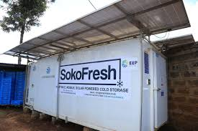
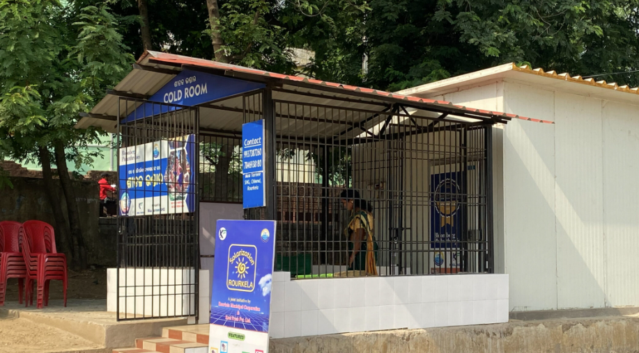
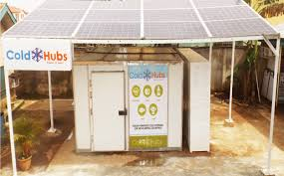
Business Models:
Cooling-as-a-Service
Koel Fresh: small solar-powered cold rooms across major areas in Rourkela, India.
SokoFresh: CaaS model in Kenya with energy-efficient cold storage.
ColdHubs: solar powered pay-as-you-store model for small-scale operators in Nigeria.
Notes:
Cooling as a service is a growing business model because it too frees consumers from having to pay high upfront costs for new equipment.
CaaS has been effectively implemented to strengthen agricultural cold chains in developing countries.
It is also an effective business model for scaling up the adoption of new technology.

Slide 6
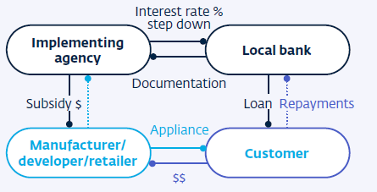

Financing Instruments: Results-Based Financing
SEforALL Universal Energy Facility
Eligible for cooling.
The fund offers a fixed subsidy for mini grid installation and covers part of the costs of standalone solar installations for productive costs.
These can be used for sustainable cooling technologies for commercial activities.
Notes:
We also looked at different financial mechanisms.
One example is Results-based financing.
This model provides incentives to projects when they reach certain key performance indicators.
This instrument is now quickly taking off under the concept of SLF – sustainable linked finance. More and more investors are committing to greening their portfolio. They are willing to take climate KPIs as part of their financial return.

Slide 7
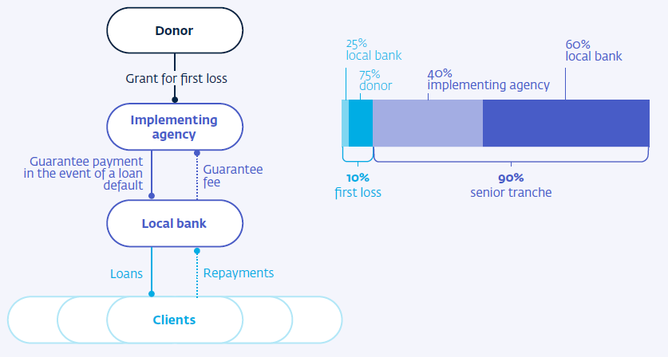
Financing Instruments: Risk Sharing Facility
IFC’s China Utility-based Energy Efficiency Finance (CHUEE)
Risk sharing facility for commercial banks.
IFC provided technical assistance and partial risk guarantee for energy efficiency loans.
Notes:
Another example is risk-sharing, where IFC has had years of successful experience.
One of IFC’s earliest energy efficiency finance projects was a risk sharing facility for commercial banks in China.
IFC provided technical assistance to help bank staff better understand the economics and risks associated with energy efficiency loans and a partial risk guarantee for any losses greater than the bank’s established performance.
This a great example where a modest applications of donor funding to cover the risk and first losses can then be leveraged many times by development banks, local lenders, and project sponsors.

Slide 8
Other Instruments
Conventional Equity
Carbon Offsets
Revolving Funds
Cooling Bonds
Working Capital Loans
Notes:
The report goes through several other structures, such as:
Conventional equity
Revolving funds
Working capital loans
As well as newer instruments such as:
Carbon offsets and
Cooling bonds
We didn’t have time to cover all of them during this webinar, but we invite you to download and read the report for more information.

Slide 9
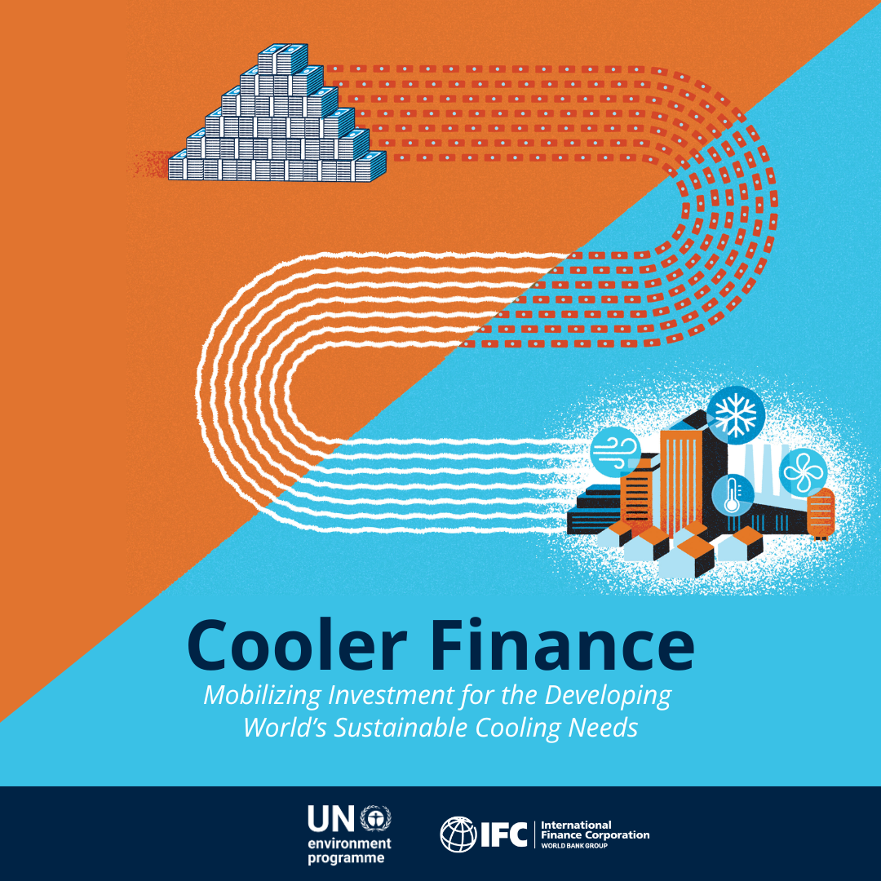

THANK YOU!
Rusmir Musić
Global Cooling Lead
IFC, Washington DC
rmusic@ifc.org
LinkedIn profile
IFC Sustainable Cooling Website
IFC's Sustainable Cooling Initiative is funded by the UK Government’s Department for Energy Security & Net Zero
Notes:
I look forward to staying connected with you – please find me on LinkedIn and stay in touch!

