Slide 1
Cool Coalition Quarterly Coordination Call
18 March 2025

Slide 2
Opening Remarks
Lily Riahi
Global Coordinator, UNEP Cool Coalition
14.00 – 14.05 CET

Slide 3
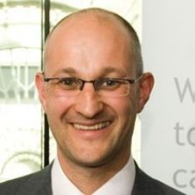
Meet the Executive
Brian Dean
Head of Energy Efficiency and Cooling, Sustainable Energy for All Initiative
Andrea Voigt
Head of global public affairs, Danfoss Climate Solutions
Dr. Graeme Maidment
Technical Lead, Cooling Department
for Energy Security and Net Zero, UK Government
Axum Teferra
Associate Director, Clean Cooling Collaborative

Slide 4
Meeting Co-chairs
Axum Teferra
Associate Director Clean Cooling Collaborative
Dr. Graeme Maidment
Technical Lead Cooling Department for Energy Security and Net-Zero UK Government

Slide 5
Agenda
14.00 -14.05 | Opening Remarks
14.05-14.20 | Governance Updates Introduction to the Steering Committee Update of the Intergovernmental Committee on Cooling (IGCC)
14.20-14.35 | Cross-cutting Policy Updates Cooling in Nationally Determined Contributions (NDCs) National Cooling Action Plans (NCAPs)
14.35-15.00 | Thematic Updates Extreme Heat & Passive Cooling Energy Efficiency Low-GWP Refrigerants & Life Cycle Refrigerant Management (LRM)
15.00-15.10 | Science and Narratives Cooling Emissions Data Global Cooling Watch 2025
15.15 -15.30 | Q&A and Closing Remarks

Slide 6
Governance Updates
14.05 – 14.20 CET

Slide 7
Introduction to the Steering Committee
Axum Teffera, Senior Associate Director, Clean Cooling Collaborative, ClimateWorks Foundation
Graeme Maidment, Lead Technical Advisor, UK Government Department of Energy Security and Net-Zero

Slide 8
Steering Committee 2024-2026

Slide 9
Update on the Intergovernmental
Committee on Cooling (IGCC)
Amr Selem, Country Engagement and
Climate Policy Lead, UNEP Cool Coalition

Slide 10
IGCC Development and Adoption
1. GCP’s establishment Phase
2. GCP’s Implementation Phase – Step (1)
Contact Group
IGCC Development
2. GCP’s Implementation Phase – Step (2)
IGCC Adoption and Operationalization
What is the IGCC?
The Intergovernmental Committee on Cooling (IGCC) for the Global Cooling Pledge comprises 72 national and 15 subnational governments that have endorsed the pledge.
Co-chaired by the UAE and Brazil (COP28 and COP30 Presidencies), the IGCC will transition to an elected leadership model by January 2026.
The IGCC will serve as an inclusive governing body for all Pledge Signatory Countries to facilitate the implementation of the GCP, specifically to:
Track progress and implementation towards achieving a 68% reduction in cooling related emissions, particularly through contributions to the Annual Pledge Progress Report.
Facilitate knowledge exchange to share progress
Develop and support the adoption of policy guidance,
Implement global outreach activities to engage Pledge’s non-Signatory countries
Propose and adopt new commitments to the Pledge
The IGCC’s approach is built on strong governance, monitoring progress, and collaborative action, ensuring that the Global Cooling Pledge is effectively implemented and progress is tracked.
Notes:
To establish the evidence base and further support piloting the NCAP Methodology, the Cool Coalition’s MENA NCAP Programme is supporting two countries to develop their NCAPs
From the signatory countries of the Global Cooling Pledge, Morocco and Tunisia are being supported to develop NCAPs. Partnership with the countries established already and the process for the NCAP development has been initiated.
Morocco’s Ministry of Energy Transition and sustainable Development is leading the NCAP development. The Ministry is in process to establish Inter-ministerial committee to oversee the NCAP development.
The NCAP would leverage Cool Coalition Methodology and cover the cross-sectoral scope including Space Cooling (Passive Cooling and EE in equipment), Cold Chain and other sectors.

Slide 11
IGCC Development and Adoption
Contact Group Meeting
Drafting and Discussion
27th of March 2025
Pledge’s Focal Points Meeting
Discussion and feedback
June 2025
Contact Group Meeting
Incorporating Feedback and Finalization
3rd of September 2025
Adoption of the IGCC at COP30 during the second Annual Ministerial Meeting
Operationalization of IGCC in January 2026
IGCC Terms of Reference
Context and mandate
Members and observers
Govrenance structure
Members and observers
Responsibilities
Co-Chairs
Secretariat
Meetings
Decision Making
Instiutitional framework
Partnerships and collabortation
Review and amendments
By joining the IGCC, Governments will support the pledge’s implementation without additional commitments, participating in Focal Points meetings, and Annual Ministerial meetings, and potentially co-chairing the committee.
Notes:
To establish the evidence base and further support piloting the NCAP Methodology, the Cool Coalition’s MENA NCAP Programme is supporting two countries to develop their NCAPs
From the signatory countries of the Global Cooling Pledge, Morocco and Tunisia are being supported to develop NCAPs. Partnership with the countries established already and the process for the NCAP development has been initiated.
Morocco’s Ministry of Energy Transition and sustainable Development is leading the NCAP development. The Ministry is in process to establish Inter-ministerial committee to oversee the NCAP development.
The NCAP would leverage Cool Coalition Methodology and cover the cross-sectoral scope including Space Cooling (Passive Cooling and EE in equipment), Cold Chain and other sectors.

Slide 12
Cross-cutting Policy Updates
14.20-14.35 CET

Slide 13
Cooling in Nationally Determined Contributions (NDCs)
Dietram Oppelt, Managing Director, HEAT

Slide 14
National Cooling Action Plans (NCAPs)
Etienne Gonin, Sustainable Cooling, Chemicals and Waste Management Technical Specialist, UNDP
Brian Dean, Director, Energy Transition at Sustainable Energy for All (SEforALL)

Slide 15
NCAP Working Group - Identifying Priority Areas for the WG 2025-26
Etienne Gonin & Jakob Hoffmann, Co-Chairs
Manjeet Singh, Cool Coalition Secretariat, UNEP
March 2025

Slide 16
Potential Ideas & Topics for collaboration 2025-26
Supporting countries with Monitoring, reporting and evaluation of NCAPs
How are responsibilities assigned? Who is responsible/accountable for individual measures/actions?
Updating existing NCAPs
What triggers update? What are the conditions?
Who is responsible/accountable for the NCAP as a whole?
What are the information flows? Who reports to whom? (identifying general structures and best practices)
What structures are in place to adapt the NCAP to changing market needs?
Do updates need to be defined in the original NCAPs?
Review process of achieved results
Global monitoring of NCAP developments (esp. for Pledge signatories)

Slide 17
Potential Ideas & Topics for collaboration 2025-26
Financing the implementation of NCAP recommendations/measures
Documenting successful attempts at finance plans for NCAPs
Financing NCAP development
Interaction with other major sustainable cooling processes (particularly MLF)
Listing of successful financial instruments development - KM
Mapping of opportunities, main donors
Domestic financing

Slide 18
Thematic Updates
14.35-15.00 CET

Slide 19
Extreme Heat & Passive Cooling
Manjeet Singh, Senior Project Specialist, Urban Cooling and Passive Cooling Expert, UNEP Cool Coalition
Huub Keizer, Board Member, International Council for Research and Innovation in Building and Construction (CIB) and Business Manager Circular Construction & International Collaboration, TNO
Graeme Maidment, Lead Technical Advisor, UK Government Department of Energy Security and Net-Zero

Slide 20
Passive Cooling WG Calendar 2025
January | February | March | April | May | June
 | WG Webinar 03 (6 Thu 14:00- CET) Nature-based Solutions |  | WG Webinar 04 (3 Thu, 17:00-CET) Thermal Comfort (1) GlobalABC Assembly in Dresden (7,8th) | WG Webinar 05 (8 Tue, 14:00-CET) Thermal Comfort (2) World Building Congress in Purdue, USA, 19-23 May | WG Webinar 06 (1st week) Cool Surface
Passive Cooling Guidelines
July | August | September | October | November | December
WG Webinar 07 (4th week) Passive Cooling in LAC |  |  | WG Webinar 08 (1st week) Natural ventilation | COP30 in Brazil (from 10 to 21) | WG Webinar 09 (1st week) Passive operation
Online Database Development under GlobalABC/Cool Coalition
COP Launch
Passive Cooling Guidelines

Slide 21
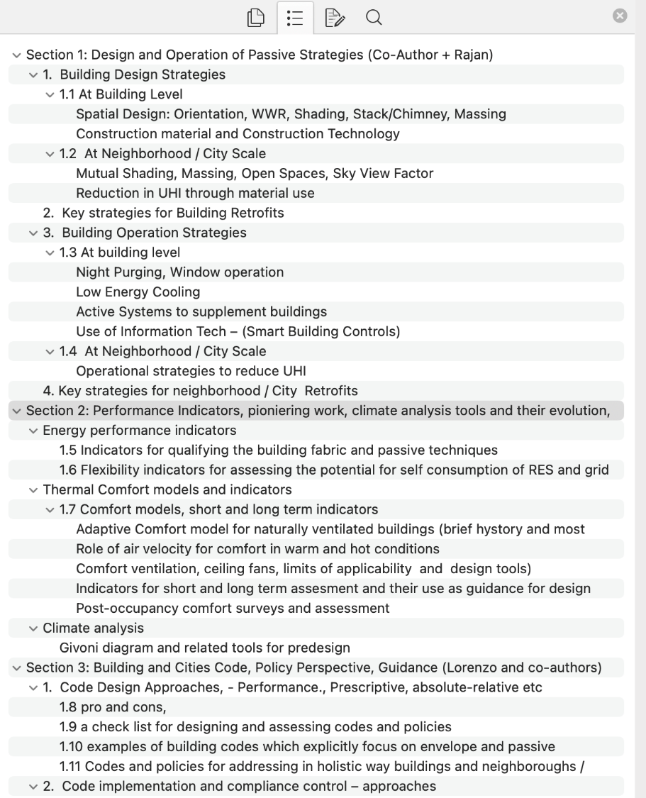
Webinars & Guidelines Development
01: Providing thermal security through energy efficient methods is a matter of survival for many regions
Guidelines
Outline
Draft
For design professionals
to support the implementation on the ground
02: Passive Cooling Strategies for Sustainable Development in Cambodia (UNEP&UNESCAP)
For policy-makers to develop/update the building energy code
03: Accelerating Nature-based Solutions for Building Energy-efficiency and Thermal Comfort
Webinars will feed into the Passive Cooling Guidelines and Online Database towards COP30, contributing to the implementation of the Global Cooling Pledge.

Slide 22
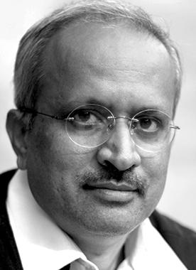
Upcoming Event
Member Workshop:
23rd CIB World Building Congress 2025
Venue: Purdue University, Indiana, USA
Date: 19-23 May 2025 (in-person workshop)
Theme: Passive Cooling and Nature-based Solutions for the Sustainable Built Environment
Please register!
https://wbc2025.cibworld.org/cib-wbc2025/wbc2025-registration/
Thank You
For queries and/or suggestions, please contact our co-chairs on the right.
To join the WG, please reach out to
UNEP: Gennai Kamata (gennai.kamata@un.org),
Manjeet Singh (manjeet.singh@un.org),
Rajan Rawal
CEPT University
(rajanrawal@cept.ac.in)
Lorenzo Pagliano
Politecnico di Milano
(Public University)
(lorenzo.pagliano@polimi.it)
Huub Keizers
TNO/CIB
(huub.keizers@tno.nl)

Slide 23
Urban Heat
Adaptation
Activities & Outputs for 2024-2026
Work Package | Activity | Team | Timeline
WP 1 | Global Standard Approach for Urban Heat/ Cooling Action Plan | UNEP Arsh- Rock SEforALL | October 2025
WP2 | Supporting Manchester Urban Heat Project | UTM | Complete
WP3 | Support implementation of Subnational Global Cooling Pledge | Arsh-Rock GCOM+UTM SEforALL WRI | -

Slide 24
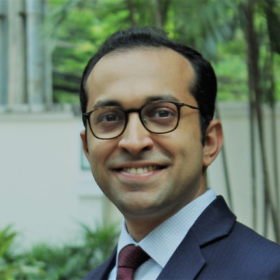
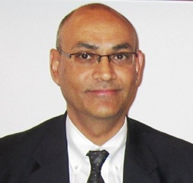
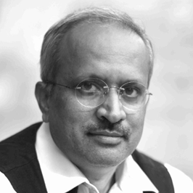
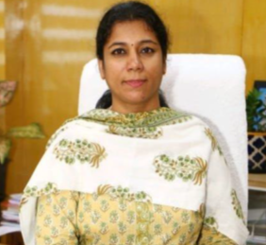
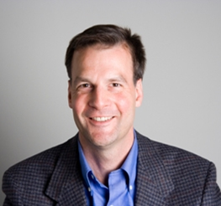
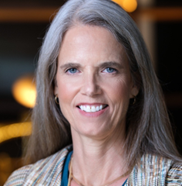
Welcome by the Chair | Eleni Myrivili, Global Chief Heat Officer, UN Habitat and Arsht-Rock
Opening - UN Secretary General’s Call to Action on Extreme Heat | Arun Jacob, Senior Advisor, Climate Action Team, Executive Office of the UN SG
Setting the Stage | Mirey Atallah, Chief of Resilience and Adaptation Branch, UNEP
Awareness & Preparedness: Urban Heat Mapping, Exposure & vulnerability Moderator, Dr. Graeme Maidment, Technical Lead Cooling - Department for Energy Security and Net Zero - UK Government | Panel Presentation Prof. Rajan Rawal, CEPT University Dr. Joy Shumake-Guillemot, Lead- WHO/ WMO Joint Climate and Health Office Sanjaya Bhatia, Head of Office, UNDRR
Redesign: Using heat mapping for urban planning | Dr. Matthias Roth, Professor of Urban Climatology, National University of Singapore Tmt. Sudha S, Member Secretary, State Planning Commission, Tamil Nadu State, India Jaya Dhindaw, Executive Program Director, Cities Program, WRI India Dr. David Fork, Research Scientist, Google
Redesigning Resilient Cities : Creating Heat/ Cooling Action Plans Moderator, Lily Riahi, Global Coordinator – UNEP Cool Coalition | Panel Discussion Owen Gow, Associate Director, Arsht-Rockefeller Foundation Resilience Centre Eugenia Kargbo, Chief Heat Officer, Freetown City, Sierra Leone Jane Gilbert, Chief Heat Officer, Miami-Dade, US Cuc Nguyen, Deputy Head, Department of Climate Change, Vietnam Maria Buhigas, Chief City Architect, Barcelona City, Spain Amy Buitenhuis, Head of Urban Heat Program - C40
Integration of Heat into NDC /ETF | Amanda Mckee, Director, NDC Partnership
Closing remarks | Gulnara Roll, Head Cities, UNEP and ExCom, Cool Coalition
Virtual Workshop : Cooling Cities: Action Planning for Extreme Heat
24th October 2024
Attended by 180 plus participants, 20 speakers from diverse organizations working on Extreme Heat.

Slide 25
Global Standard Approach for Urban Heat/Cooling Action Plan inclusive of Urban Heat Vulnerability Mapping
Next steps
Pool of experts develop a standard methodology along with data resource mapping
What should be the content
Methodology for Urban Heat Mapping
Science based approach on Identifying parameters causing increase in air temperatures
Evaluation methodology for Urban Heat Adaptation and Mitigation Measures
Methodology for Base line and projected GHG emission scenarios for cooling
Develop a proposal

Slide 26
Subnational Global Cooling Pledge
Commit to incorporate cooling in an existing strategy or action plan or develop a Heat Action Plan by 2026, to mitigate and adapt to urban heat through sustainable cooling solutions;
Subnational Cooling Pledge
Expression of Interest – 32
Pledge received – 15
Leveraging Cool Coalition partners to reach 500 cities by 2030
Commit to significantly increase the area and quality of green and blue spaces in urban areas for cooling by 2030 in line with the Paris Agreement goals and Target 12 of the Kunming-Montreal Global Biodiversity Framework;
Meeting with Subnational Signatories for updates
SEforALL supporting HAP development in Kenya subnational signatories
UNDRR is supporting HAP development in Brazil
Common challenges – capacity building & guidelines on Nature & public procurement.
Commit to pursue public procurement of low-global warming potential and high efficiency cooling technologies focused on the lowest lifecycle cost in government buildings by 2030.

Slide 27
Energy Efficiency
Patrick Blake, Programme Manager, United for Efficiency, UNEP

Slide 28
Low-GWP Refrigerants & Life Cycle Refrigerant Management (LRM)
• Denise San Valentin, Programme Management Officer, Climate & Clean Air Coalition

Slide 29
Science and Narratives
15.00-15.15 CET

Slide 30
Cooling Emissions Data
Xinfang Wang, Associate Professor, Birmingham Energy Institute, University of Birmingham, and
Cooling Emissions Specialist,
Department for Energy Security and Net Zero (DESNZ)

Slide 31
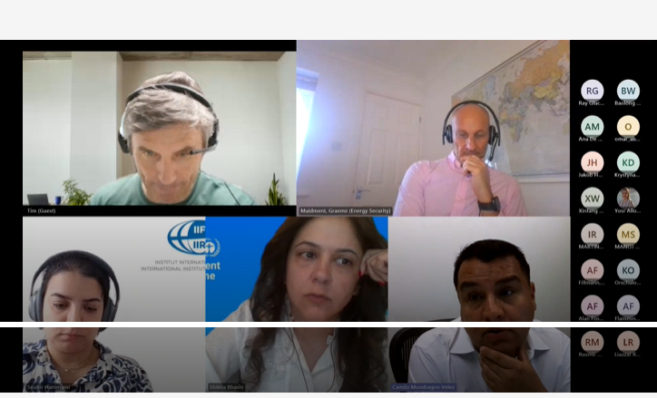
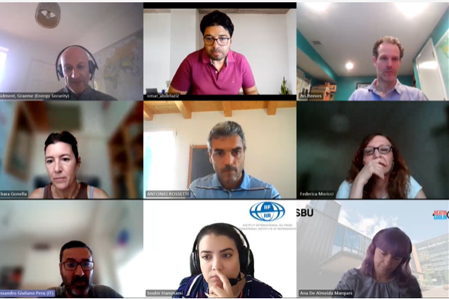
CREED Working Group
Cooling and Refrigeration Emissions and Energy Working Group
Objectives
Bring together those working in this area
Assimilate methodologies, and create converges in terminology/nomenclature of 'cooling' sectors
Collate assumptions and available datasets
Align on indicators for data (and proxies) necessary to measure progress in sustainable cooling

Slide 32
CREED: Work Packages and Outputs
Work Package (WP) number | What | Who leads
WP1 | To support the Global Cooling Pledge | Ray Gluckman
WP2 | To develop harmonised approach to categorise cooling data | Xinfang; Mustafa
WP3 | To develop proxies for estimation | Omar Abdelaziz
WP4 | To create a forum and communicate activities that disseminate findings | Souhir Hammami
WP5 | To update the Life Cycle Climate Performance guidelines | Yunho Hwang
Support the delivery of:
Global Cooling Pledge Progress Report annually, including at COP29, Baku
Global Cooling Watch report, planned for COP30, Brazil
Monitoring system for the Global Cooling Pledge
Data and proxy indicators for evidence of sustainable cooling

Slide 33
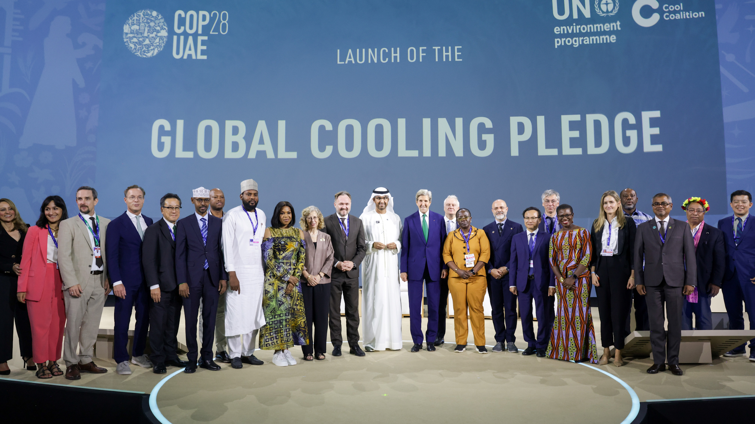
CREED: Benefits of being involved
High profile
Sharing of data between us
Potential for future collaborations
Opportunities to explore new sectors
Modelling opportunities
Confidentiality
Global Cooling Pledge:
2050: Cut cooling related emissions by 68%.
2030: enhance energy efficiency by 50%
You are very welcome to join us and get involved! To join, please write to anya.magotra@un.org

Slide 34
Global Cooling Watch 2025
Ray Gluckman, Director, Gluckman Consulting

Slide 35
Q&A and Closing Remarks
Axum Teffera, Senior Associate Director, Clean Cooling Collaborative, ClimateWorks Foundation
Graeme Maidment, Lead Technical Advisor, UK Government Department of Energy Security and Net-Zero
15:15 – 15:30 CET

Slide 36
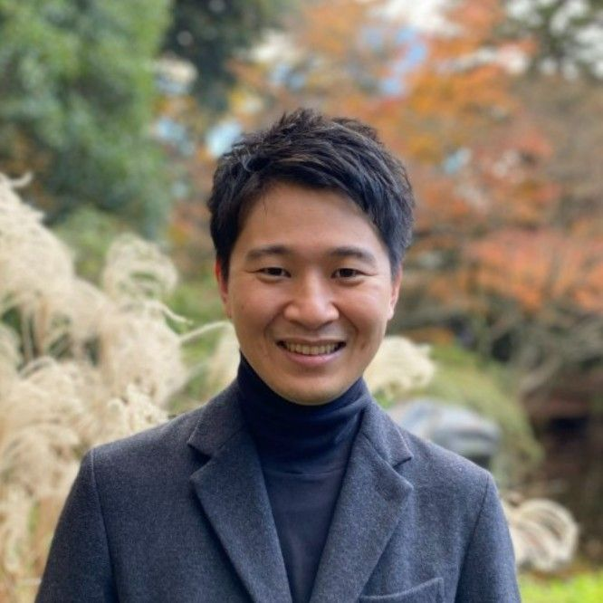
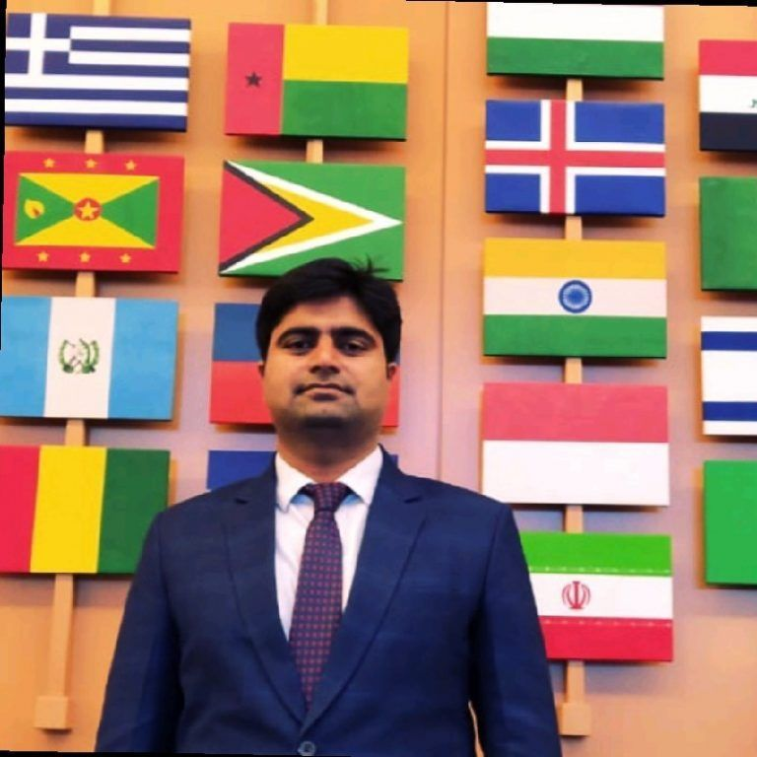
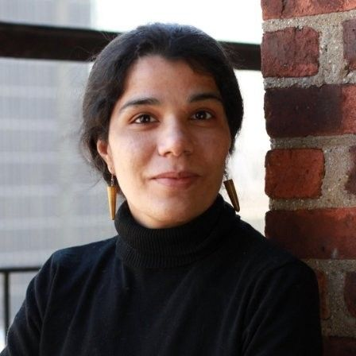
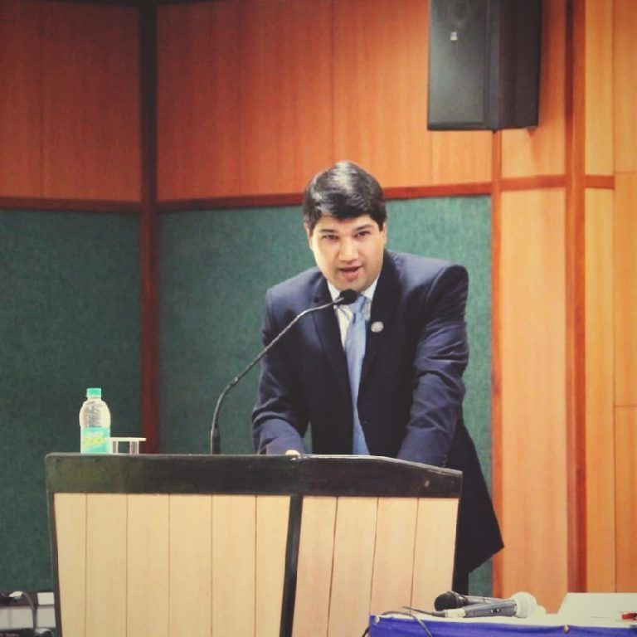
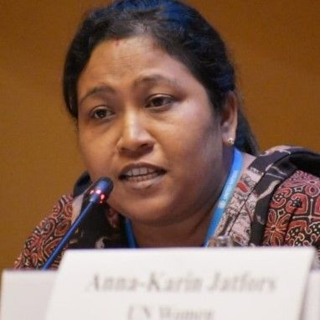
Thank you for your participation,
from all of us at UNEP-Cool Coalition!
Shikha Bhasin
Advisor – Partnerships and Governance
Shikha.bhasin@un.org
Amr Saleem
Advisor – Country Engagement and Policy
Amr.Seleem@un.org
Benjamin Hickman
Project Manager - Cooling and Cold Chains Global Lead
Benjamin.hickman@un.org
Luis Munuera
Project Manager – Urban Energy Global
munuera.luis@gmail.com
Gennai Kamata
Associate Officer, Buildings and Cooling (Cambodia, Nature for Cooling)
Gennai.kamata@un.org
Minni Sastry
Advisor – Extreme Heat
Minni.Sastry@un.org
Manjeet Singh
Project Specialist – Passive Cooling in Southeast Asia
Manjeet.singh@un.org
Marisofi Giannouli
Communications Lead
marisofi.giannouli@un.org
Anya Magotra Governance and Partnerships - Coordinator
anya.magotra@un.org
Leyla Prézelin
Junior Project Specialist, Passive Cooling
leyla.prezelin@un.org
Aarti Nain
Advisor for Urban Cooling and Heat Risk Mitigation, India
Aarti.Nain@un.org
Angshuman Siddhanta
Project Specialist - Cold Chains, India
angshuman.Siddhanta@un.org
Priscah Osir
Project Management Support
Priscah.osir@un.org
Parimita Mohanty
Senior Advisor – Cooling -Cold Chain Finance in Asia
mohantyp@un.org
Sophie Loran
Global Lead – Advocacy and Communications
Sophie.loran@un.org
Lily Riahi
Global Coordinator, Cool Coalition and Urban Energy
Lily.riahi@un.org
Notes:
We see a strong political momentum for sustainable cooling. G7 and G20 current and past cycles have stated cooling as a priority in their agendas.
COP28 UAE presidency has included cooling as a key mitigation and adaptation factor in its official programming on December 5 - Energy and Industry Day when the Spotlight report will be launched.
COP28UAE is also spearheading a Global Cooling Pledge, with technical support from UNEP. The Pledge builds on the report’s recommendations, alongside technical consultations with over 100 stakeholders and 50 countries thanks to the support of regional offices.
The Pledge is a golden opportunity to table for the first time an intergovernmental commitment to address the cooling sector in a holistic manner and open horizons for further action in the global arena in relation to the sustainable cooling.
India’s G20 presidency called for action on “energy efficient cooling” in the Outcome Document on Energy.

