Slide 1



WG Activity Calendar 2025
January | February | March | April | May | June
 | WG Webinar 03 (6 Thu 14:00- CET) |  | WG Webinar 04 (3 Thu, 17:00-CET) GlobalABC Assembly in Dresden (7,8th) | WG Webinar 05 (8 Tue, 14:00-CET) World Building Congress in Purdue, USA, 19-23 May | WG Webinar 06 (1st week)
Passive Cooling Guidelines
July | August | September | October | November | December
WG Webinar 07 (4th week) |  |  | WG Webinar 08 (1st week) | COP30 in Brazil (from 10 to 21) | WG Webinar 09 (1st week)
Online Database Development under GlobalABC/Cool Coalition
COP Launch
Passive Cooling Guidelines

Slide 2
WG Webinars 2025
Date & Time | Topic
WG Webinar 03 (6 Feb Thu 14:00- CET) | Nature-based Solution for Cooling
WG Webinar 04 (3 April Thu 17:00- CEST) | Energy & Comfort Indicator + open access calculation tools (1)
WG Webinar 05 (8 May Tue 14:00- CEST) | Energy & Comfort Indicator + open access calculation tools (2)
WG Webinar 06 The first week of June | Cool Surface
WG Webinar 07 The first week of July | Passive Cooling Project in LAC
WG Webinar 08 The first week of October | Natural Ventilation
WG Webinar 09 The first week of December | Passive design/construction/operation (*specific content to be confirmed)

Slide 3
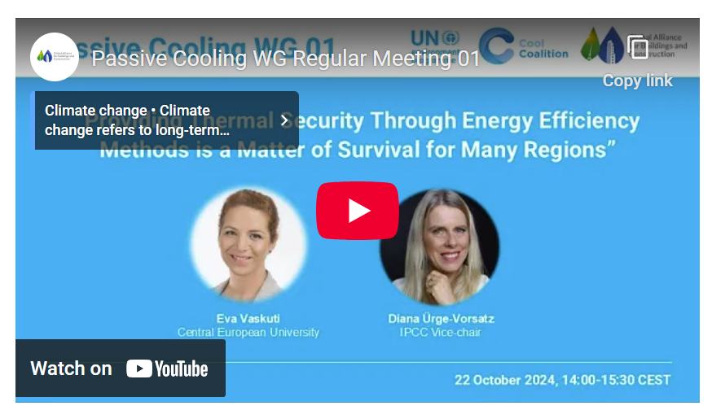
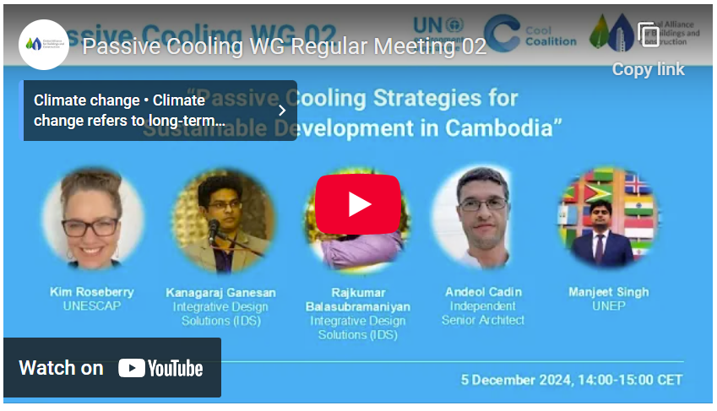
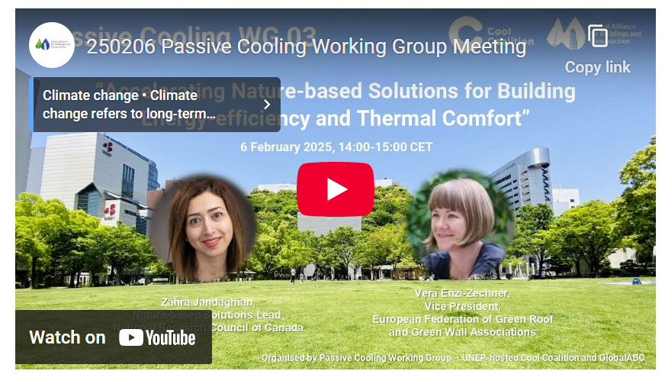
Webinars
01: Providing thermal security through energy efficient methods is a matter of survival for many regions
02: Passive Cooling Strategies for Sustainable Development in Cambodia (UNEP&UNESCAP)
03: Accelerating Nature-based Solutions for Building Energy-efficiency and Thermal Comfort
Webinars will feed into the Passive Cooling Guidelines and Online Database towards COP30, contributing to the implementation of the Global Cooling Pledge.

Slide 4
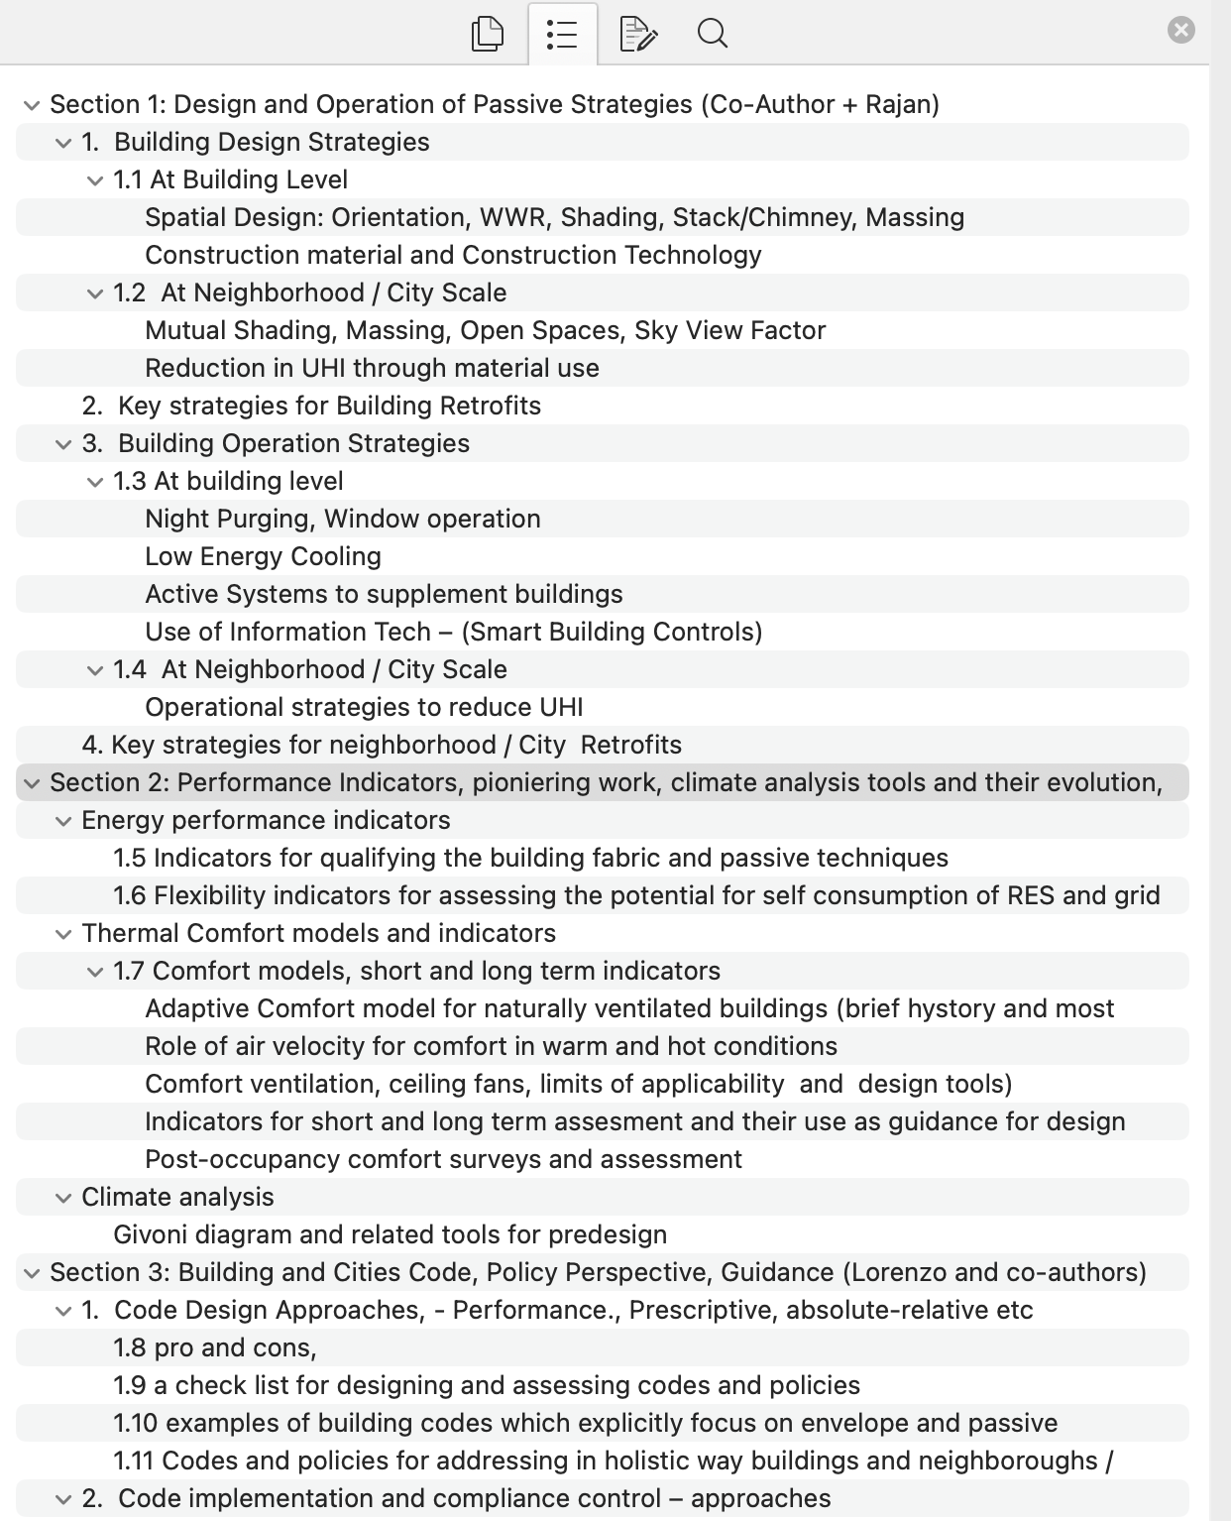
Passive Cooling Guidelines
Passive Cooling Guidelines are intended for;
1: policy-makers
Supporting the development/updating of the building energy codes that incorporate passive cooling strategies.
2: Design professionals
Supporting the implementation of the passive cooling strategies on the ground.
Draft
More details are coming shortly

Slide 5


Member Workshop
23rd CIB World Building Congress 2025
Venue: Purdue University, West Lafayette, Indiana, USA
Date: 19-23 May 2025 (in-person workshop)
Theme: Passive Cooling and Nature-based Solutions for the Sustainable Built Environment
Please register!
https://wbc2025.cibworld.org/cib-wbc2025/wbc2025-registration/

Slide 6
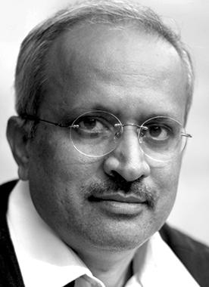
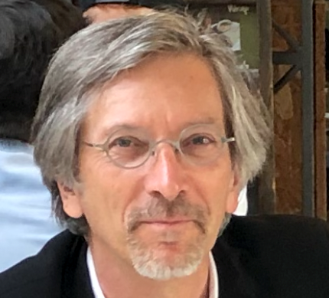
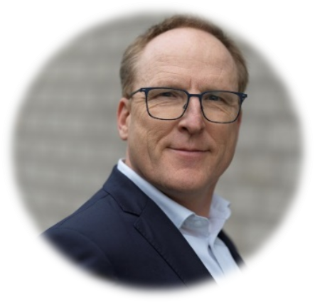
Co-chair Contacts
Rajan Rawal
CEPT University
(rajanrawal@cept.ac.in)
Lorenzo Pagliano
Politecnico di Milano
(Public University)
(lorenzo.pagliano@polimi.it)
Huub Keizers
TNO/CIB
(huub.keizers@tno.nl)
To join, please reach out to
UNEP: Gennai Kamata (gennai.kamata@un.org), Manjeet Singh (manjeet.singh@un.org),

